Slide 1
EMERGENCY MANAGEMENT SYSTEM
SARVESH SAWANT –002927710
MEHABOOBJAN SHAIK - 002921815
ROHIT MONE - 002193976

Slide 2
PROBLEM STATEMENT
CREATING AND MANAGING MULTIPLE NETWORKS IN CASE OF AN EMERGENCY SITUATION.
USING THROUGH THIS APPLICATION, USER CAN GET IN CONTACT WITH HOSPITAL , POLICE, NGO, FIRE DEPARTMENT, ETC;
WE CAN CREATE NETWORKS, ENTERPRISES AS WELL AS ADD USERS TO THE ORGANIZATION.

Slide 3
APPROACH
Assist
Help persons who are in problem by resolving there issue as soon as possible
Provide
Provide appropriate care/support
Connect
Connect people during emergency with all the medical, law enforcement, mental health treatments they need to get back on their feet and avoid repeat catastrophes.

Slide 4
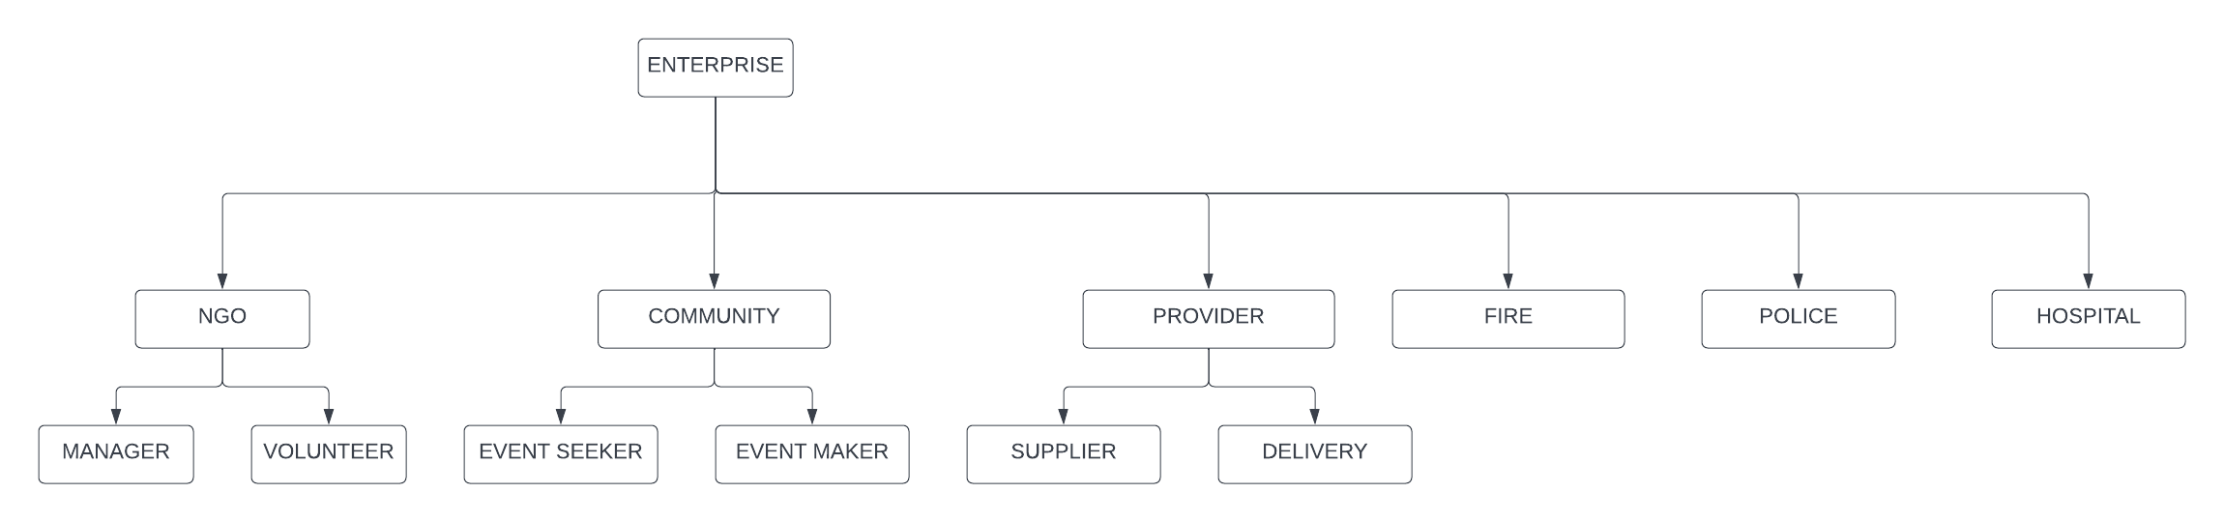
OBJECT MODEL

Slide 5
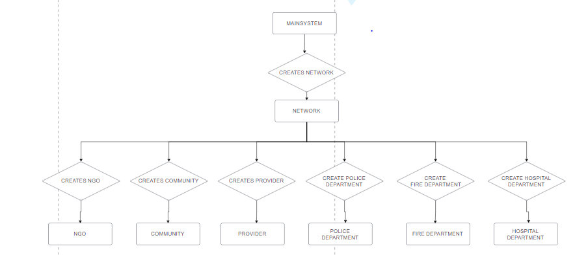
SYSTEM ADMIN

Slide 6
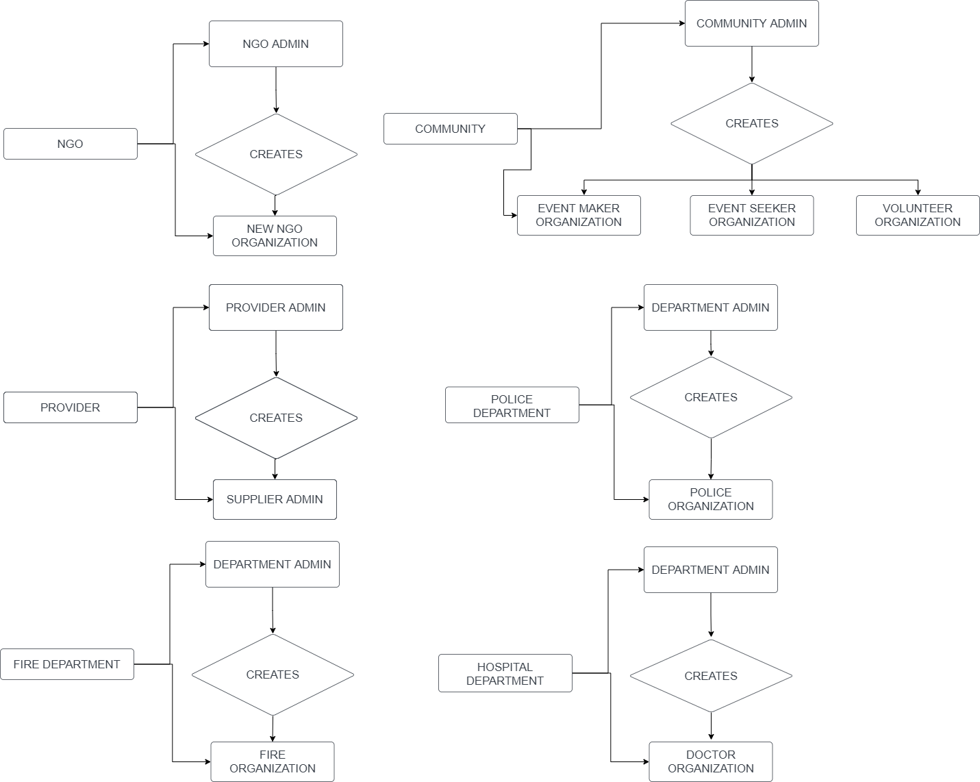
ENTERPRISE

Slide 7
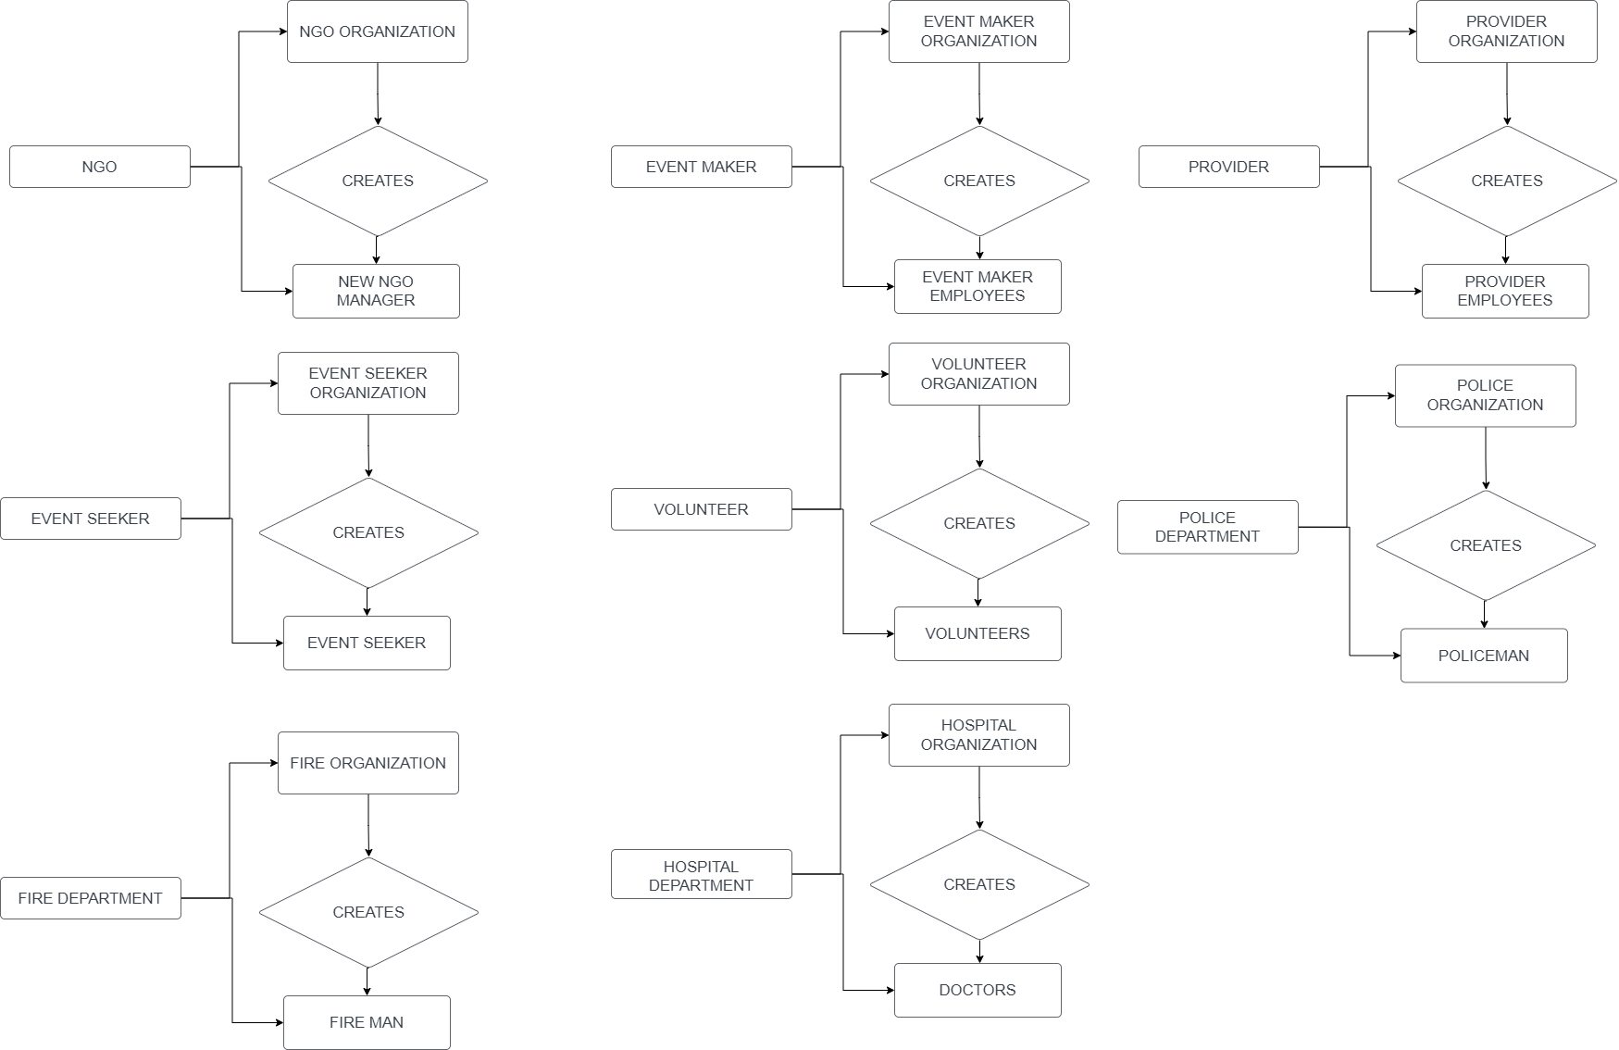
ORGANIZATION

Slide 8
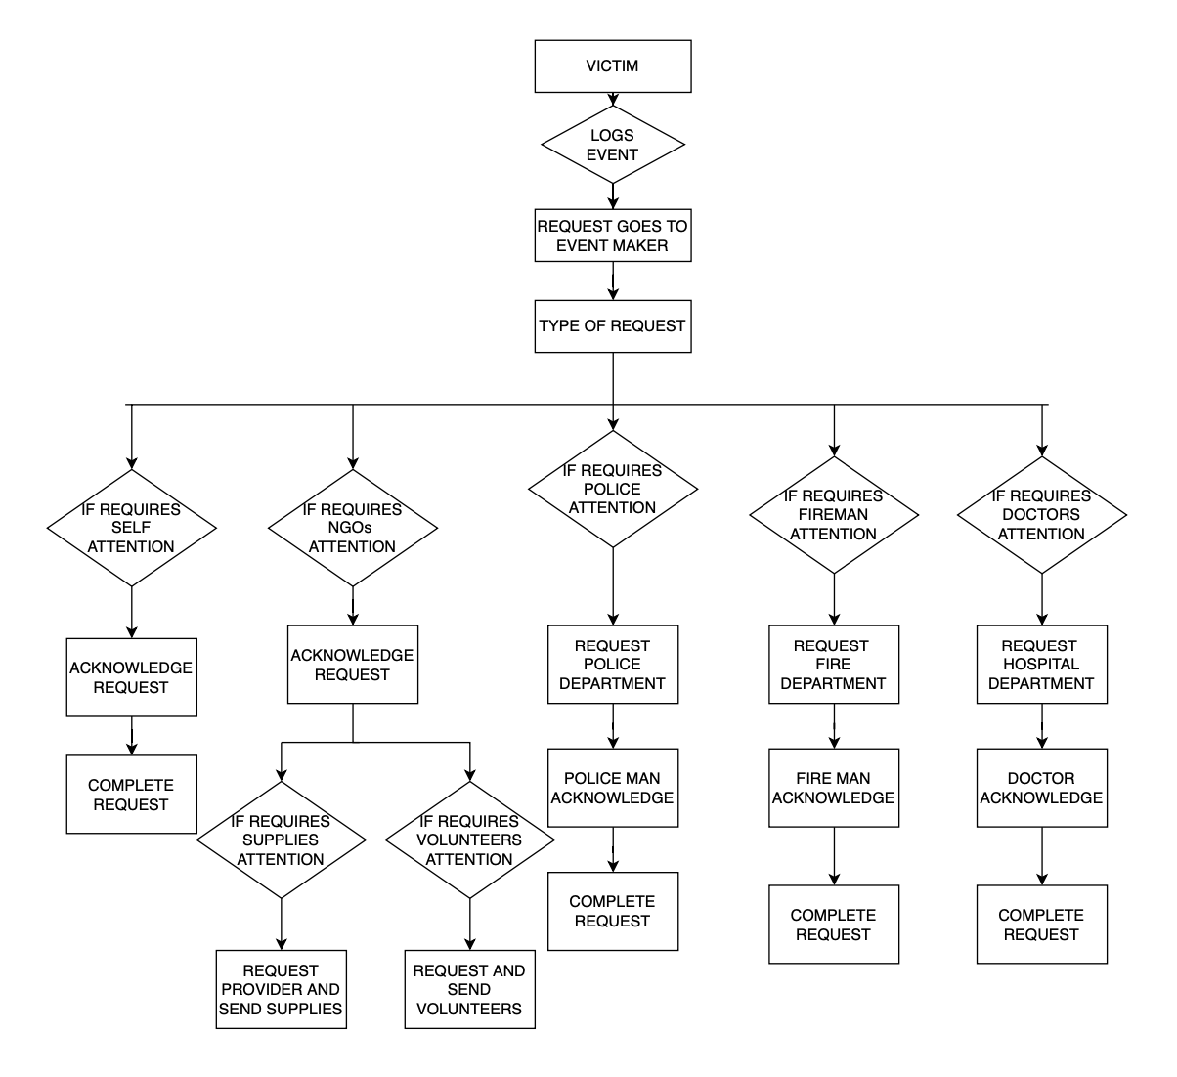
SYSTEM FLOW

Slide 9

Roles
SYSTEM ADMIN
MANAGER
VOLUNTEER
EVENT MAKER
EVENT SEEKER
SUPPLIER
DELIVERY
POLICE DEPARTMENT
FIRE DEPARTMENT
HOSPITAL DEPARTMENT

Slide 10
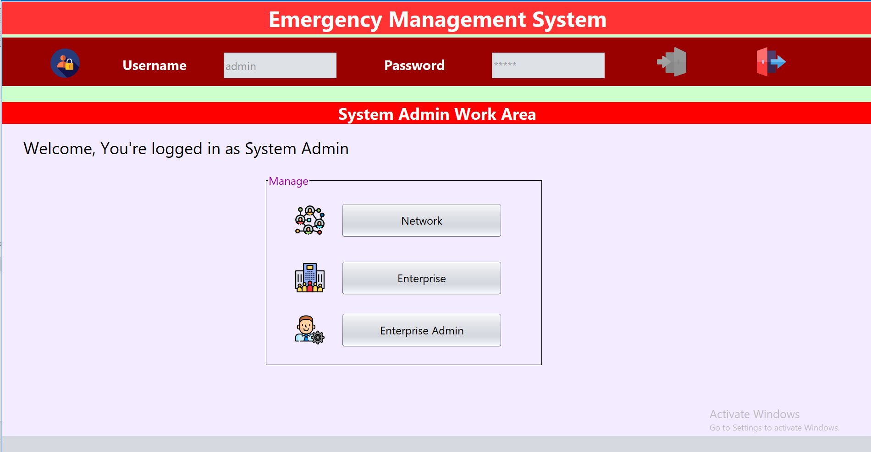
User Interface for System Admin

Slide 11
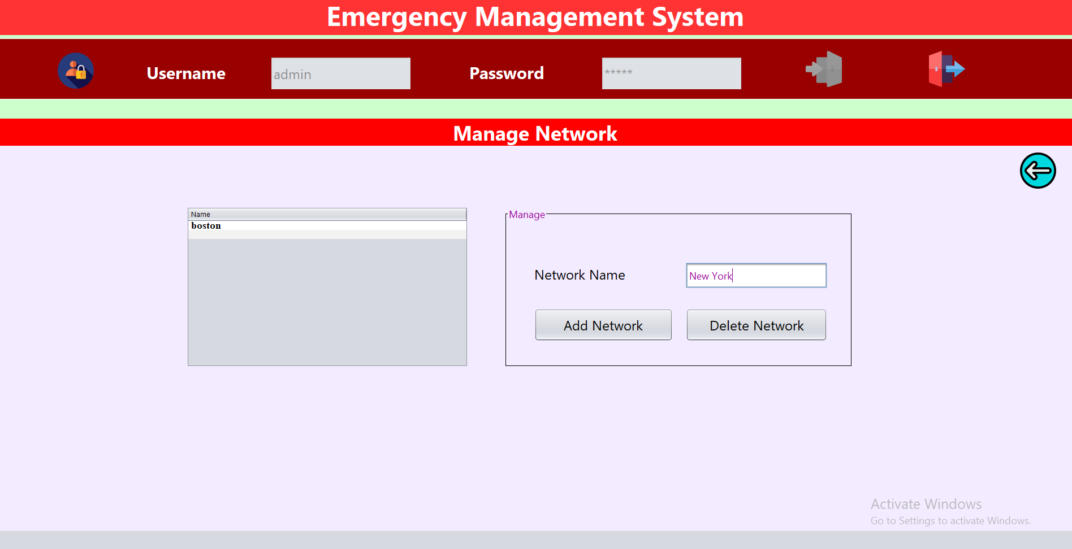
User Interface to manage Network

Slide 12
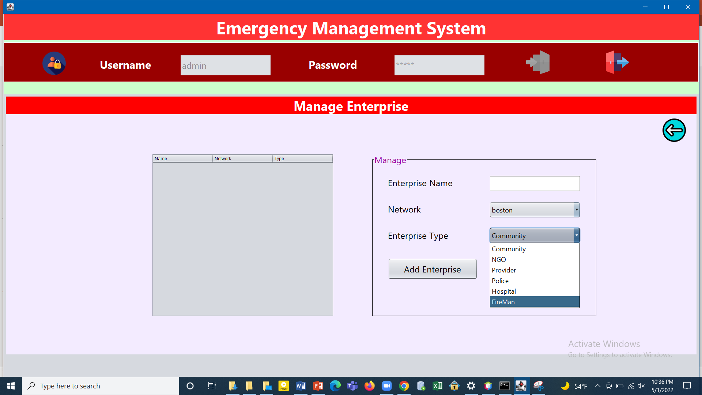
User Interface to manage Enterprise

Slide 13
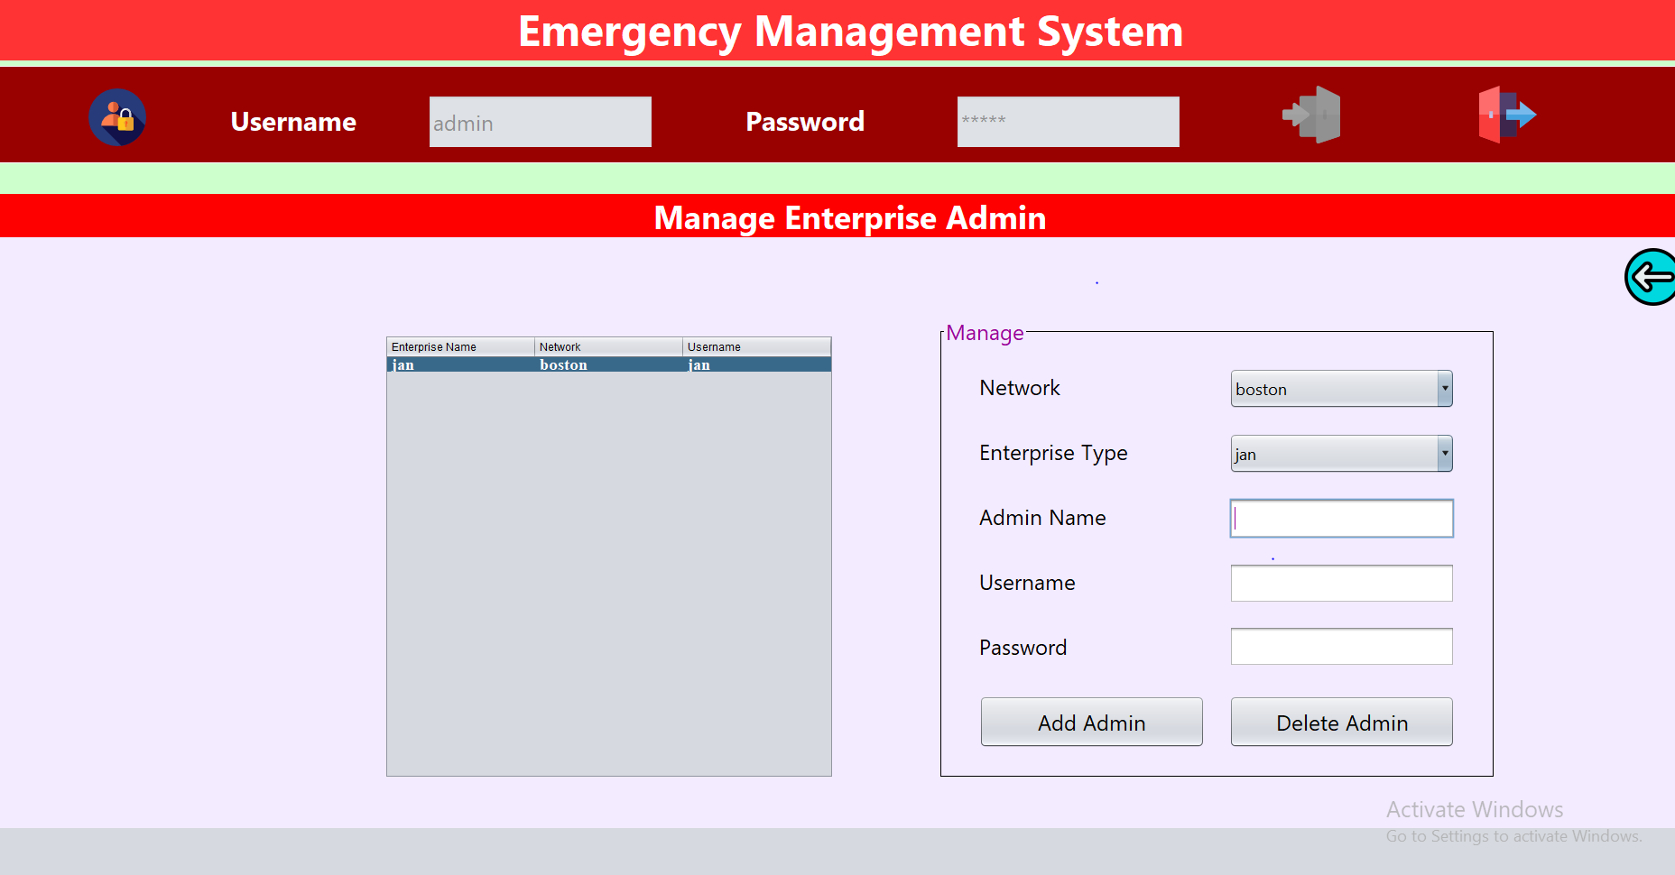
User Interface to manage Enterprise Admin users

Slide 14
Conclusion:
We can implement this system to include a large network with all the emergency requirements needed.
This application connects victims and the emergency services in an event of emergency.

Slide 15
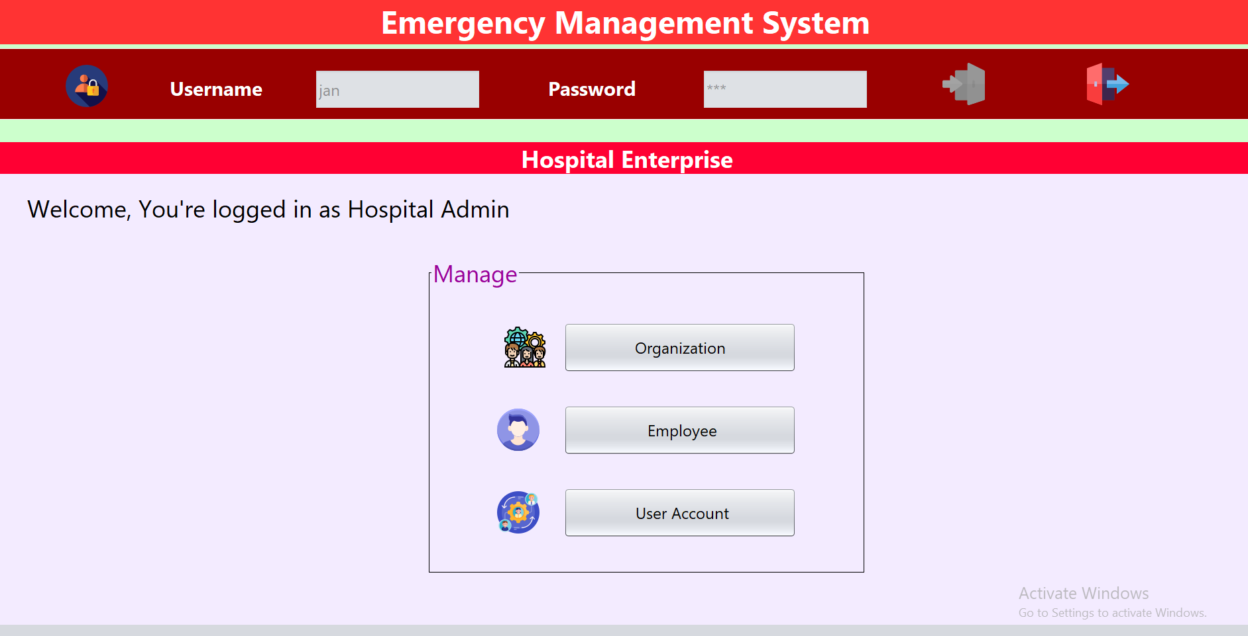
User Interface of Hospital Enterprise admin

